Slide 1
Output Delivery System (ODS)
Statistics 6740
Lecture 38

Slide 2
Lecture Outline
Questions
Final Exam Preview
Overview of ODS
ODS statements
ODS destinations
ODS options
Examples
In-class homework preview
Daily assignment

Slide 3
Final Exam Preview
Will post exam on Carmen on Wednesday, December 9 before class and discuss it in class
Two linked datasets
Seven tasks
Input data
Manipulate and combine data
Produce table of summary statistics
Produce bar chart
Produce scatterplots
Produce summary plot
Save data
Several additional conditions
Program format, titles, footnotes, comments
Submit ONLY SAS program by 4 pm on Thursday, December 17.

Slide 4
Overview of ODS
The SAS Output Delivery System (ODS) has been designed to overcome the limitations of traditional SAS output and to make it easy to make new formatting options available to users. ODS is a method of delivering output in a variety of formats and of making the formatted output easy to access. Important features of ODS include the following:
ODS combines raw data with one or more table definitions to produce one or more output objects. These objects can be sent to any or all ODS destinations. The currently available ODS destinations can produce an output data set, traditional monospace output, output that is formatted for a high-resolution printer, and output that is formatted in HyperText Markup Language (HTML).
ODS provides table definitions that define the structure of the output from procedures and from the DATA step. You can customize the output by modifying these definitions or by creating your own.
ODS provides a way for you to choose individual output objects to send to ODS destinations. For instance, PROC UNIVARIATE produces five output objects. You can easily create HTML output, an output data set, traditional Listing output, or Printer output from any or all of these output objects. You can send different output objects to different destinations.
ODS stores a link to each output object in the Results folder in the Results window.

Slide 5
SAS ODS Statements
ODS statements are global statements that can be used anywhere in a SAS program
Usually either outside DATA/PROCs or inside PROCs
ODS statements direct/redirect or capture program output
ODS statements can also be used to summarize information about output status
Common uses
Capturing SAS procedure output into SAS datasets
Redirecting output to a file
Selecting/limiting output from procedures

Slide 6
ODS Destinations
HTML – Results Viewer or HTML file
DOCUMENT
LISTING – OUTPUT window
OUTPUT – SAS dataset
PRINTER – printable output in PCL, PDF, or PS
RTF – RTF file
GRAPHICS
LATEX – LaTeX file

Slide 7
ODS Statements
Open a destination
ODS HTML file-specifications;
ODS LISTING;
ODS OUTPUT output-object = datasetname;
ODS PRINTER file-specifications;
ODS RTF file-specifications;
Close destination
ODS HTML CLOSE;
ODS LISTING CLOSE;
ODS OUTPUT CLOSE;
ODS PRINTER CLOSE;
ODS RTF CLOSE;
ODS _ALL_ CLOSE;
file-specifications define file name, TOC file, page contents

Slide 8
More ODS Statements
Choose parts of procedure output
ODS EXCLUDE <ODS-destination> output-objects;
ODS SELECT <ODS-destination> output-objects;
Show current ODS status
ODS SHOW;
List available output objects
ODS TRACE ON/OFF;
output-object is the SAS name for an element of a procedure output

Slide 9
More Detail on ODS PRINTER
ODS PRINTER <action>;
CLOSE, EXCLUDE, SELECT, SHOW
ODS PRINTER <options>;
FILE=filename or fileref;
PRINTER = printername;
PDF, PCL, PS
File reference information
AUTHOR=, TITLE=, SUBJECT=, TEXT=

Slide 10
Examples
BLL plotting program
ODS with UNIVARIATE procedure

Slide 11
HW 6 Preview – Problem A
Use the college data from the previous homework assignments
Create SAS macro that allows user to select a region and college type and produce a summary report that includes the following information:
Graphics-level chart of mean salary by rank (Asst, Assoc, Full), along with total number of faculty (region and type in title)
Table of t-test results comparing mean salaries between ranks for each state within region and type
I will provide initial program to read and combine data and add region

Slide 12
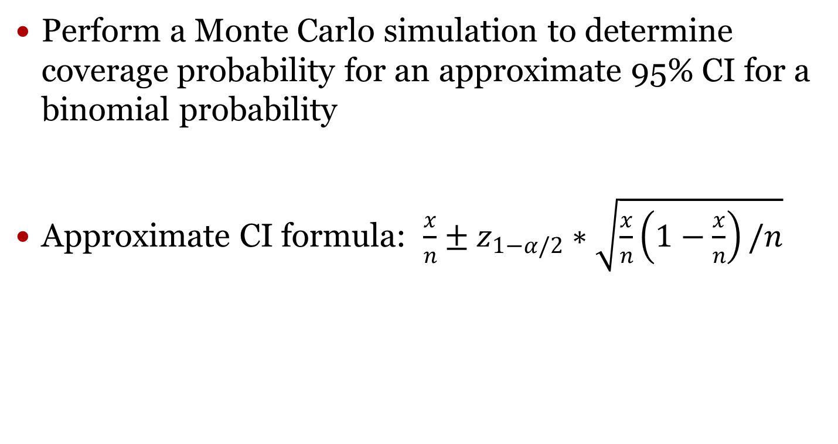
HW 6 Preview – Problem B
Perform a Monte Carlo simulation to determine coverage probability for an approximate 95% CI for a binomial probability
Approximate CI formula: $\frac{x}{n}±z_{1−α/2}∗\sqrt{\frac{x}{n}\left(1−\frac{x}{n}\right)/n}$

Slide 13
Daily Assignment
Prepare for in-class homework

